Slide 1
JSPM’s
Bhivarabai Sawant institute of technology and research, wagholi
Unit 6: Software Quality Tools
Prof. Adsure Sharad S.

Slide 2
Vision Mission
Institute Vision
"Satisfy the aspirations of youth force, who want to lead nation towards prosperity through techno-economic development."
Institute Mission
To provide, nurture and maintain an environment of high academic excellence, research & entrepreneurship for all aspiring students, which will prepare them to face global challenges maintaining high ethical and moral standards."
Department Vision
Empowering the students to be professionally competent & socially responsible for techno-economic development of society.
Department Mission
To provide quality education enabling students for higher studies, research & entrepreneurship
To inculcate professionalism and ethical values through day to day practices.

Slide 3
Objective
Present an overview of Seven Quality Tools
Address purpose and applications
Highlight benefits

Slide 4
Why Do This?
The Deming Chain
  Improve Quality
  Decrease Costs
  Improve Productivity
  Decrease Price
  Increase Market
  Stay in Business
  Provide More Jobs
  Return on Investment
Notes:
Why are we doing this?
Because companies with quality programs make more profit. Return on investment is increased.

Slide 5
Six Problem Solving Steps
Identify
  recognize the symptoms
Define
  Agree on the problem and set boundaries
Investigate
  Collect data
Analyze
  Use quality tools to aid
Solve
  Develop the solution and implement
Confirm
  Follow up to ensure that the solution is effective
Notes:
Identify – must be hands on to recognize the problem
Define – Knowing that there is a problem, set up the conditions to sole it
Investigate – perform tests and collect data so you can react to facts. Seat of the pants decision making is forbidden.
Analyze – Use the quality tools to aid in understanding the problem
Solve – Using the data and quality tools come up with the solution and implement it. When implementing the solution it is imperative that the management monitor the implementation at every step. People are resistant to change and must be hounded to ensure it is implemented as envisioned. This is why it is good to have employees involved in the process integral to the solution. It is also the idea behind suggestion programs.
Confirm – Follow up!

Slide 6
Seven Quality Tools
Cause and Effect Diagrams
Flow Charts
Checksheets
Histograms
Pareto Charts
Control Charts
Scatter Diagrams
Notes:
Cause and Effect diagrams – Ishikawa diagrams of Fishbone diagrams
Top down and Linear flow
Simple check sheets which lead to Histograms
Histograms leading to Pareto charts
Pareto charts
Scatter charts
All of these tools are related

Slide 7
Quality Tool Brainstorming
Rules
Diverse group
Go around room and get input from all – one idea per turn
Continue until ideas are exhausted
No criticism
Group ideas that go together
Look for answers
Notes:
Brainstorming Rules
Best in a diverse group of people
Record ideas in a visible way – black board, easel…
All ideas are valid
Go around room until ideas are exhausted
Discuss ideas

Slide 8
Quality Tool
Cause and Effect Diagrams

Slide 9
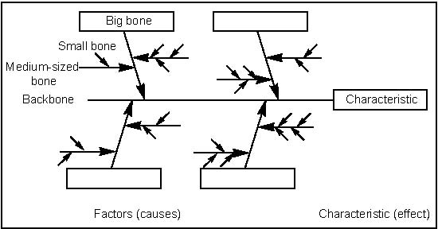
Fishbone Diagram
Purpose: Graphical representation of the trail leading to the root cause of a problem
How is it done?
  Decide which quality characteristic, outcome or effect you want to examine (may use Pareto chart)
  Backbone –draw straight line
  Ribs – categories
  Medium size bones –secondary causes
  Small bones – root causes
Notes:
Man, material, machine, method, environment, measurement (sometimes)
Separate various causes into identifiable groups
Good basis for showing you where data should be collected

Slide 10
Cause & Effect Diagrams
Benefits:
Breaks problems down into bite-size pieces to find root cause
Fosters team work
Common understanding of factors causing the problem
Road map to verify picture of the process
Follows brainstorming relationship
Notes:
Brainstorm the causes under each category
Sometimes just performing the fishbone diagram will enable the problem to be resolved by understanding

Slide 11
Cause & Effect Diagrams
Manpower
Materials
Typos
Source info incorrect
Wrong source info
Didn’t follow proc.
Dyslexic Transposition
Wrong purchase order
Poor training
Incorrect shipping documents
Glare on display
Temp.
Corrupt data
Environment
No training
No procedure
Keyboard sticks
No communications
Software problem
Methods
Machine

Slide 12
Quality Tool
Flow Charts

Slide 13
Flow Charts
Purpose:
Visual illustration of the sequence of operations required to complete a task
    Schematic drawing of the process to measure or improve.
    Starting point for process improvement
    Potential weakness in the process are made visual.
    Picture of process as it should be.
Benefits:
    Identify process improvements
    Understand the process
    Shows duplicated effort and other non-value-added steps
    Clarify working relationships between people and organizations
    Target specific steps in the process for improvement.

Slide 14
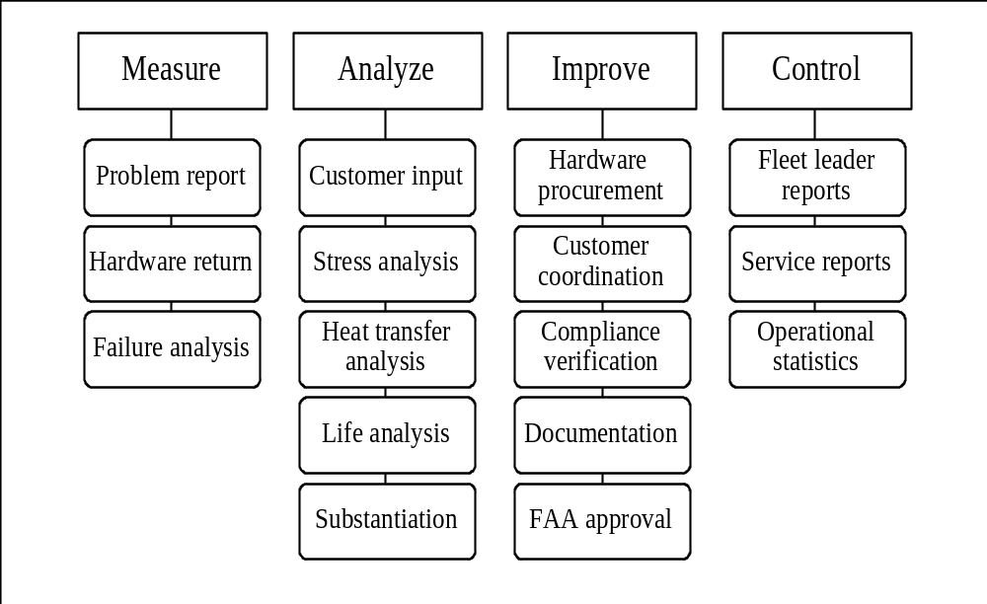
Flow Charts
Top Down
Benefits
  Simplest of all flowcharts
  Used for planning new processes or examining existing one
  Keep people focused on the whole process
How is it done?
  List major steps
  Write them across top of the chart
  List sub-steps under each in order they occur

Slide 15
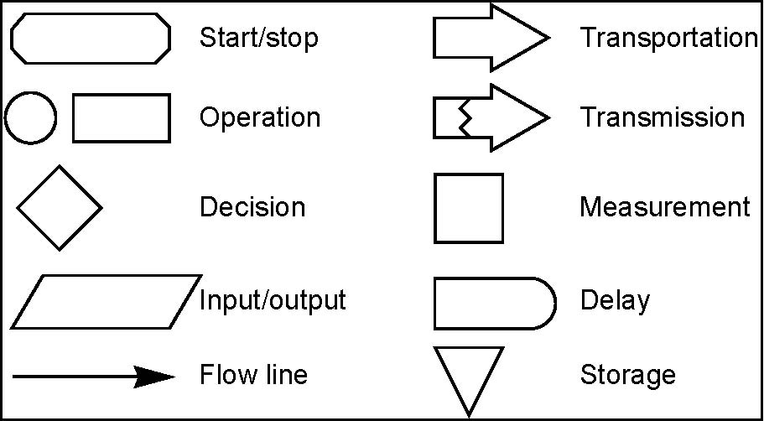
Flow charts
Linear
Benefits
Show what actually happens at each step in the process
Show what happens when non-standard events occur
Graphically display processes to identify redundancies and other wasted effort
How is it done?
Write the process step inside each symbol
Connect the Symbols with arrows showing the direction of flow
Toolbox

Slide 16
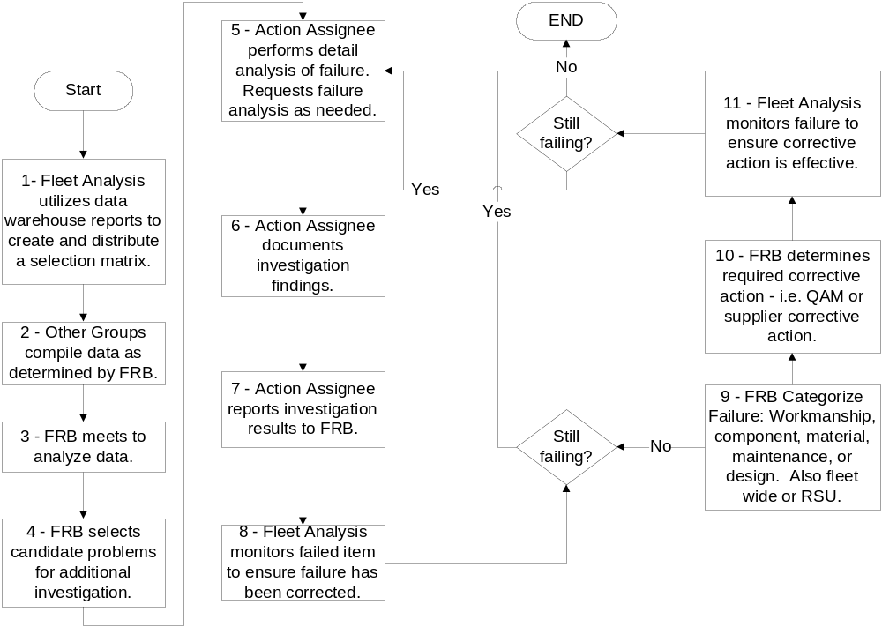
Quality Tool
Sample Linear Flow

Slide 17
Quality Tool
Checksheets

Slide 18
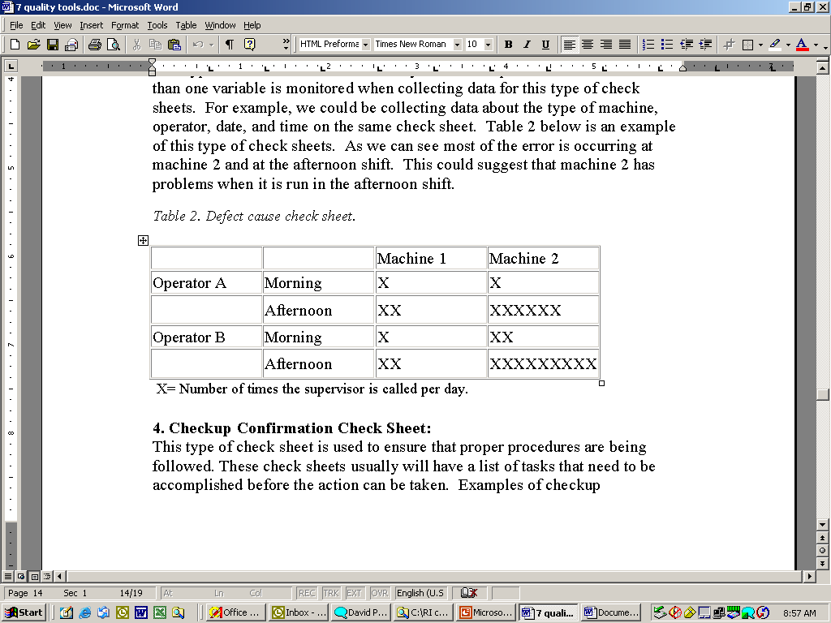
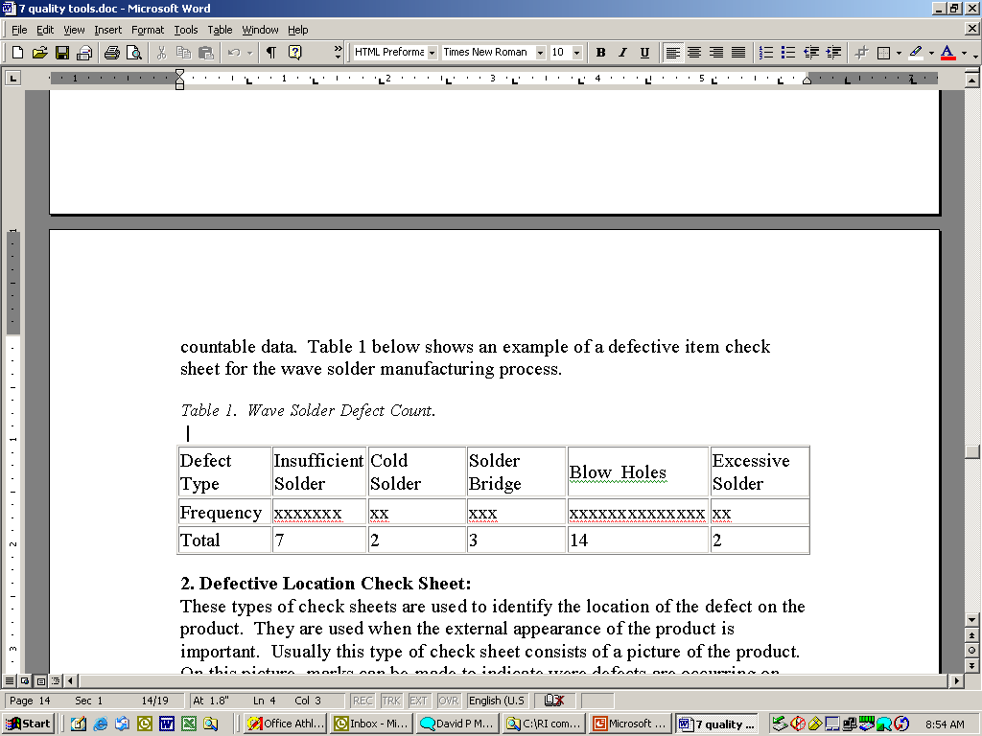
Checksheets
Purpose:
  Tool for collecting and organizing measured or counted data
  Data collected can be used as input data for other quality tools
Benefits:
  Collect data in a systematic and organized manner
  To determine source of problem
  To facilitate classification of data (stratification)
Notes:
In the top chart we see two operators and two machines. In the morning both operators and both machines seem to be working well. However in the afternoon we see both operators are more prone to defects and the machine two is very prone to problems. We conclude there may be some operator fatigue involved AND that there is some condition on machine two that needs to be investigated. Look for something that affects on machine but not the other like sun glare…
Conditions
Workers
Material

Slide 19
Quality Control Tool
Histograms

Slide 20
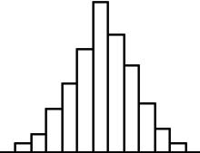
Histograms
Purpose:
To determine the spread or variation of a set of data points in a graphical form
How is it done?:
Collect data, 50-100 data point
Determine the range of the data
Calculate the size of the class interval
Divide data points into classes Determine the class boundary
Count # of data points in each class
Draw the histogram
Stable process, exhibiting bell shape
Notes:
Displays distributions
Remember the bell curve from school… a few Fs many Bs and Cs a few As.

Slide 21
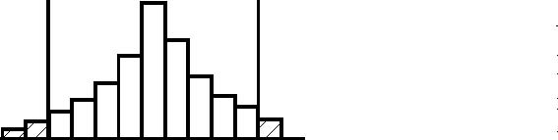
Histograms
Benefits:
Allows you to understand at a glance the variation that exists in a process
The shape of the histogram will show process behavior
Often, it will tell you to dig deeper for otherwise unseen causes of variation.
The shape and size of the dispersion will help identify otherwise hidden sources of variation
Used to determine the capability of a process
Starting point for the improvement process
Notes:
A histogram is a picture of the statistical variation in your process. Not only can histograms help you know which processes need improvement they can also help you track that improvement
This is a process that has too much variation to meet specifications no matter how it is centered. Action must be taken to reduce variation in this process

Slide 22
Quality Control Tool
Pareto Charts

Slide 23
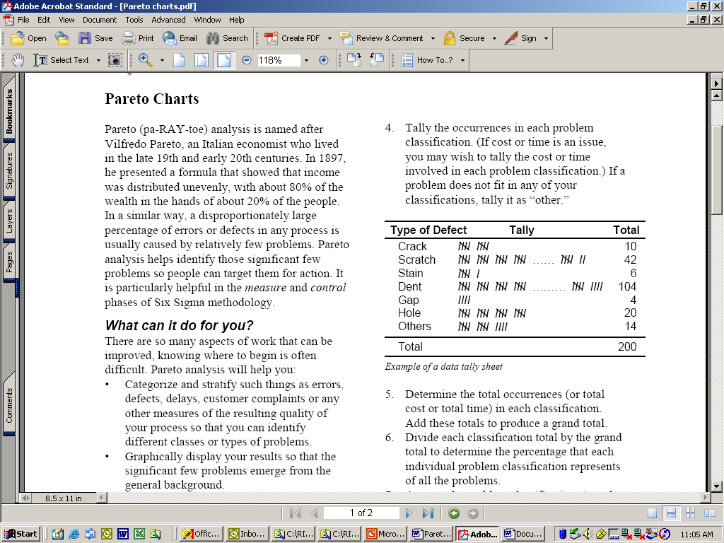
Pareto Charts
Purpose:
Prioritize problems.
How is it done?
Create a preliminary list of problem classifications.
Tally the occurrences in each problem classification.
Arrange each classification in order from highest to lowest
Construct the bar chart
Notes:
Column graph in rank order
80% of problems related by 20% of causes
The vital few and the trivial many – Dr. Juran
Identifies problems to be worked first

Slide 24
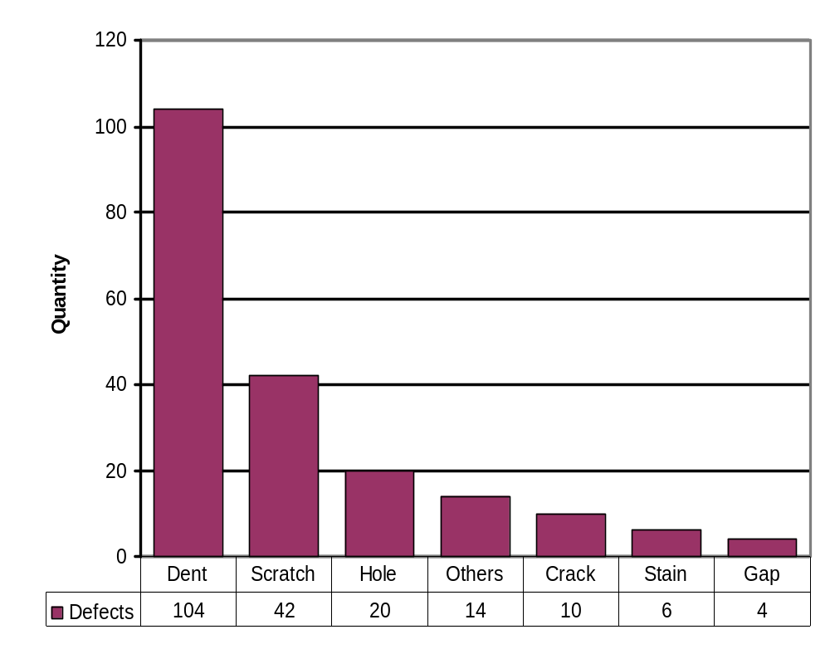
Pareto Charts
Benefits:
Pareto analysis helps graphically display results so the significant few problems emerge from the general background
It tells you what to work on first
Notes:
Conclusion:
We need to concentrate on dents
Its good that there are not many gaps because they are very expensive.
TRAP
This works sometimes but another type of chart is frequently better

Slide 25
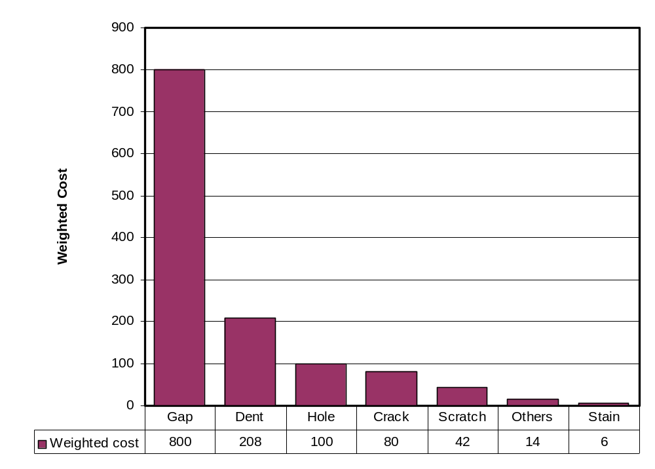
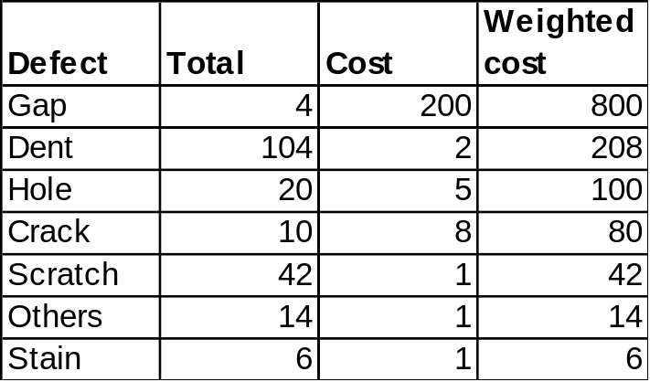
Pareto Charts
Pareto Charts
Weighted Pareto
Weighted Pareto charts use the quantity of defects multiplied by their cost to determine the order.
Notes:
Defects times cost
Gap becomes the obvious place to start corrective actions
Costs more than all others put together!!!

Slide 26
Quality Control Tool
Control Charts
Notes:
Now that you know which area to look from the Cause and Effect Diagrams
Brainstorming
Flow Charts
Check sheets
Histograms
Pareto Charts
you need some basic information on how to monitor processes.

Slide 27
Control Charts
Purpose:
The primary purpose of a control chart is to predict expected product outcome.
Benefits:
Predict process out of control and out of specification limits
Distinguish between specific, identifiable causes of variation
Can be used for statistical process control

Slide 28
Control Charts
Strategy for eliminating assignable-cause variation:
  Get timely data so that you see the effect of the assignable cause soon after it occurs.
  As soon as you see something that indicates that an assignable cause of variation has happened, search for the cause.
  Change tools to compensate for the assignable cause.
Strategy for reducing common-cause variation:
  Do not attempt to explain the difference between any of the values or data points produced by a stable system in control.
  Reducing common-cause variation usually requires making fundamental changes in your process
Notes:
Assignable cause – also known as special cause
Specific problems
Need to be identified quickly to stabilize process
Dull/broken drill, incorrect tool…
Common cause
Normal
Hard to eliminate
Fixed by changes to process
Example is run out in a drill press.

Slide 29
Control Charts
Control Chart Decision Tree
  Determine Sample size (n)
  Variable or Attribute Data
    Variable is measured on a continuous scale
    Attribute is occurrences in n observations
  Determine if sample size is constant or changing
Notes:
There are many types of control charts. Based on the type of data you collect there is a chart for you.
Make decisions based on type of data and sample size.
VARIABLE CHARTS
X bar using R - small sample size – 3 to 5 <7 controls
X bar using S – large sample size - >7
IndX using MR - when rational subgroups are not possible
ATTRIBUTE CHARTS
P chart – sample is large and changeable
Np chart - sample is large constant
C chart – constant unit – one item – defects per unit
U chart – changeable average defects per unit

Slide 30
Control Charts
Control Chart Decision Tree
X bar , R
n = 2 to 10
n >10
X bar, S
Variable data
n = 1
IX, Moving Range
Start
Constant n
p (fraction defective) or
np (number def. Per sample
Attribute Data
Percent data
Changing n
p
Count data
Constant n
c (defects per sample or
u defects per unit
Changing n
u

Slide 31
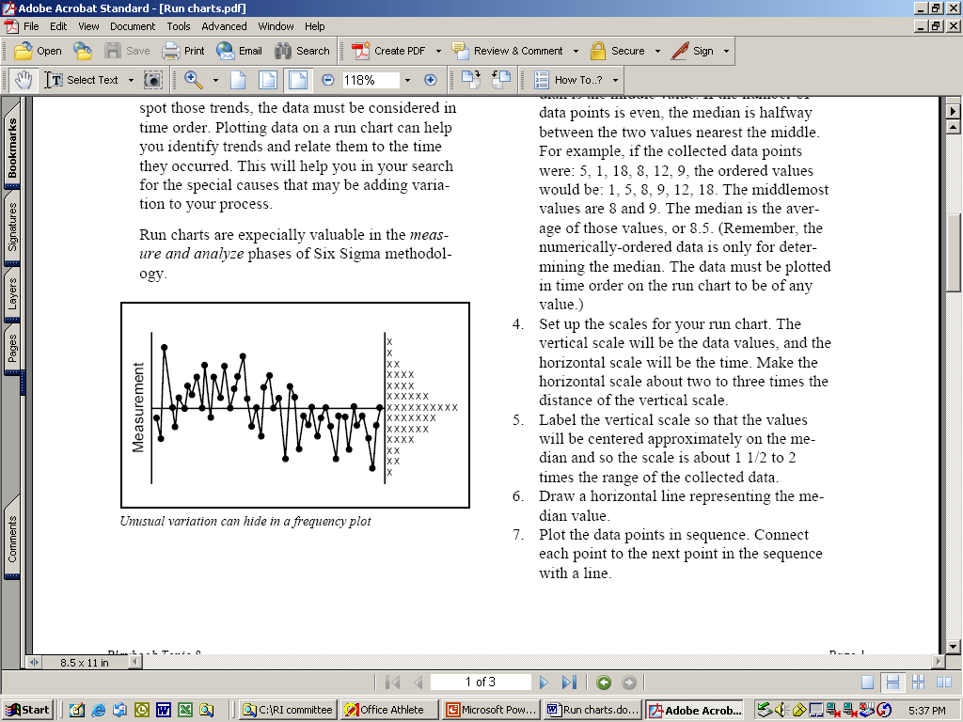
Control Charts
What does it look like?
Adding the element of time will help clarify your understanding of the causes of variation in the processes.
A run chart is a line graph of data points organized in time sequence and centered on the median data value.
Notes:
The patterns in the run chart can help you find where to look for assignable causes of variation.
A Run Chart can show you trends or help pinpoint unusual events.

Slide 32
Control Charts
Individual X charts
How is it done?
The data must have a normal distribution (bell curve).
Have 20 or more data points. Fifteen is the absolute minimum.
List the data points in time order. Determine the range between each of the consecutive data points.
Find the mean or average of the data point values.
Calculate the control limits (three standard deviations)
Set up the scales for your control chart.
Draw a solid line representing the data mean.
Draw the upper and lower control limits.
Plot the data points in time sequence.

Slide 33
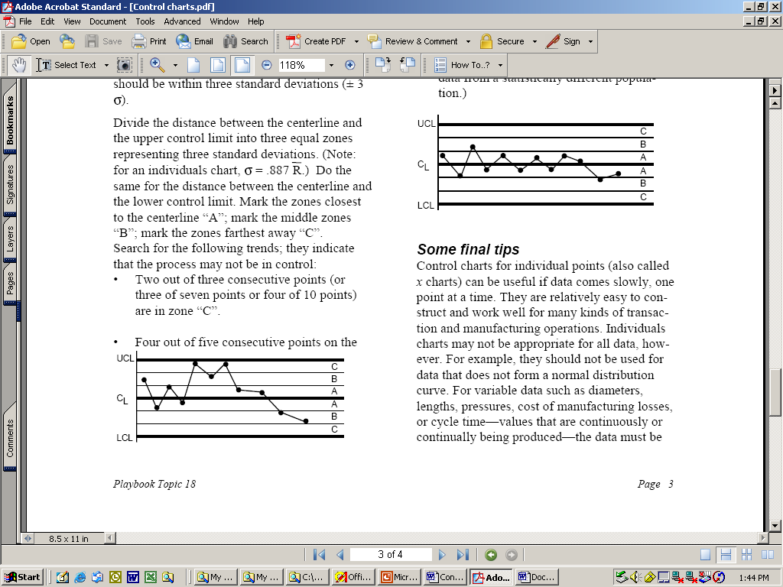
Control Charts
Next, look at the upper and lower control limits. If your process is in control, 99.73% of all the data points will be inside those lines.
The upper and lower control limits represent three standard deviations on either side of the mean.
Divide the distance between the centerline and the upper control limit into three equal zones representing three standard deviations.

Slide 34
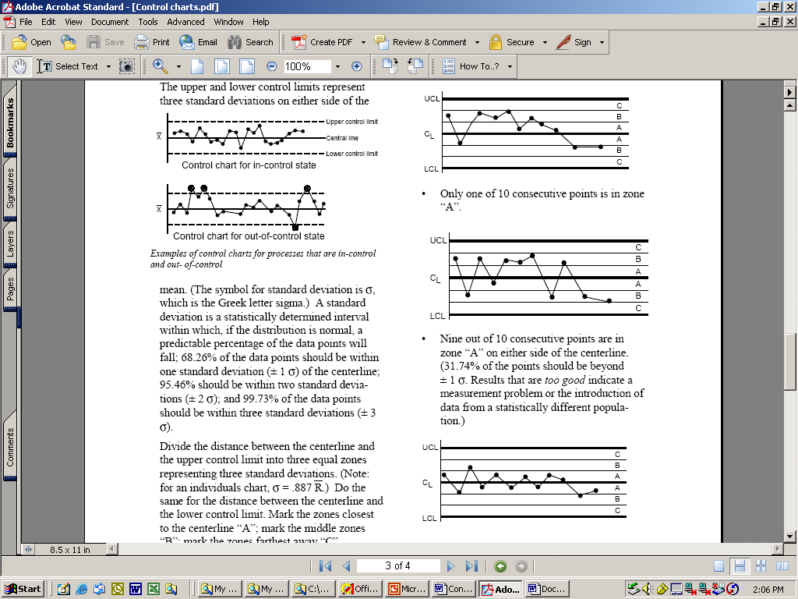
Control Charts
Search for trends:
  Two out of three consecutive points are in zone “C”
  Four out of five consecutive points on the same side of the center line are on zone “B” or “C”
  Only one of 10 consecutive points is in zone “A”
Notes:
Trends indicate that the process may not be in control
One point beyond 3 sigma
2 of 3 points between 2 and 3 sigma
4 of 5 points above2 sigma
8 points in a row in any zone

Slide 35
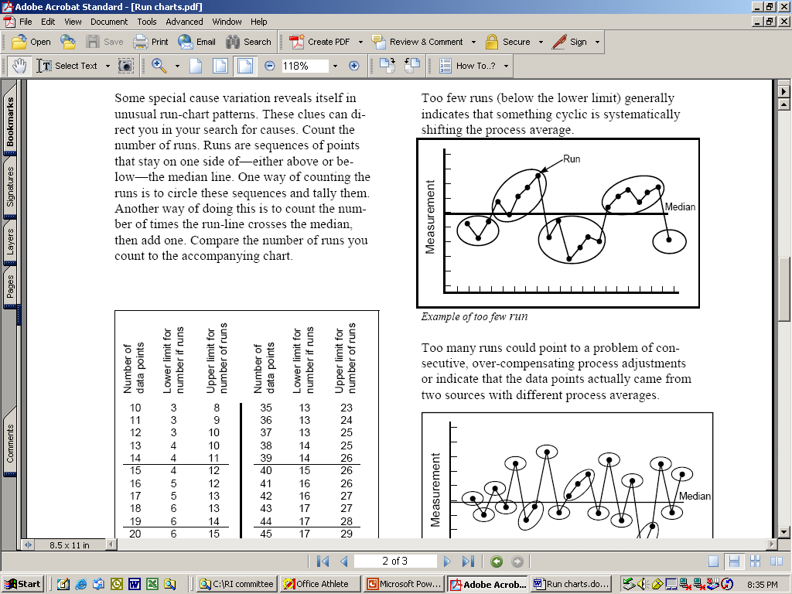
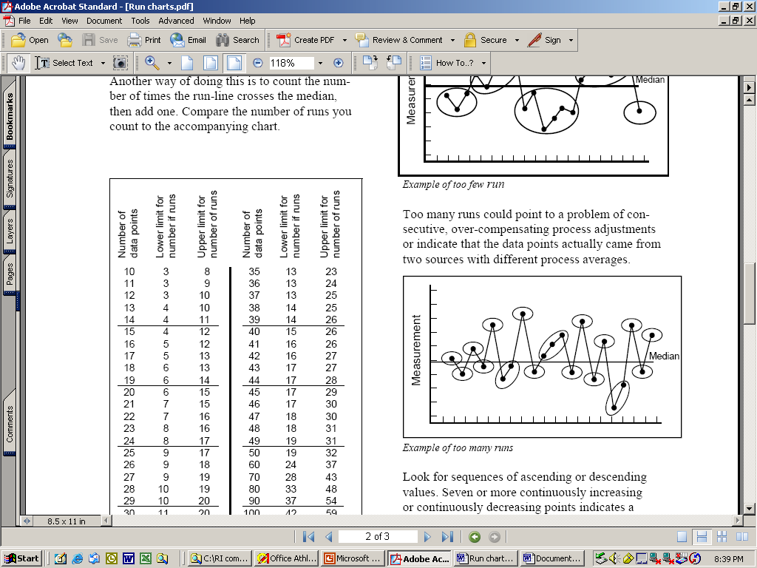
Control Charts
Basic Control Charts interpretation rules:
  Specials are any points above the UCL or below the LCL
  A Run violation is seven or more consecutive points above or below the center (20-25 plot points)
  A trend violation is any upward or downward movement of five or more consecutive points or drifts of seven or more points (10-20 plot points)
  A 1-in-20 violation is more than one point in twenty consecutive points close to the center line

Slide 36
Quality Control Tool
Scatter Diagrams

Slide 37
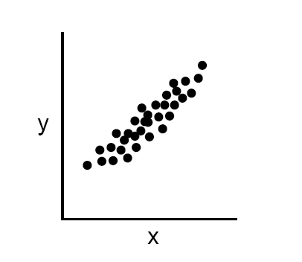
Scatter Diagrams
Purpose:
To identify the correlations that might exist between a quality characteristic and a factor that might be driving it
A scatter diagram shows the correlation between two variables in a process.
  These variables could be a Critical To Quality (CTQ) characteristic and a factor affecting it two factors affecting a CTQ or two related quality characteristics.
Dots representing data points are scattered on the diagram.
  The extent to which the dots cluster together in a line across the diagram shows the strength with which the two factors are related.
Notes:
Shows relationship between two variables

Slide 38
Scatter Diagrams
How is it done?:
  Decide which paired factors you want to examine. Both factors must be measurable on some incremental linear scale.
  Collect 30 to 100 paired data points.
  Find the highest and lowest value for both variables.
  Draw the vertical (y) and horizontal (x) axes of a graph.
  Plot the data
  Title the diagram
The shape that the cluster of dots takes will tell you something about the relationship between the two variables that you tested.

Slide 39
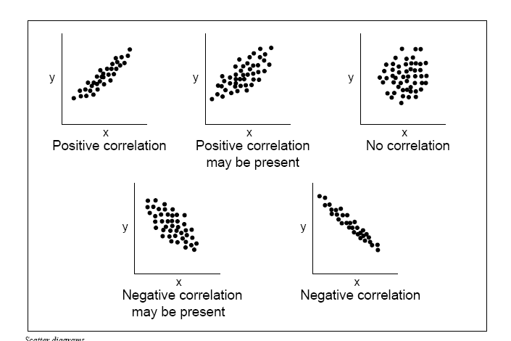
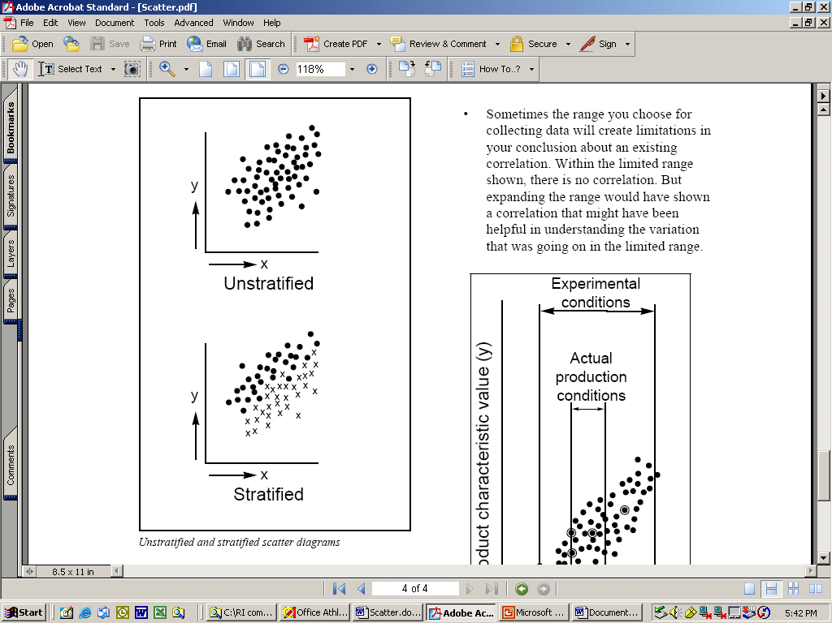
Scatter Diagrams
If the variables are correlated, when one changes the other probably also changes.
Dots that look like they are trying to form a line are strongly correlated.
Sometimes the scatter plot may show little correlation when all the data are considered at once.
  Stratifying the data, that is, breaking it into two or more groups based on some difference such as the equipment used, the time of day, some variation in materials or differences in the people involved, may show surprising results

Slide 40
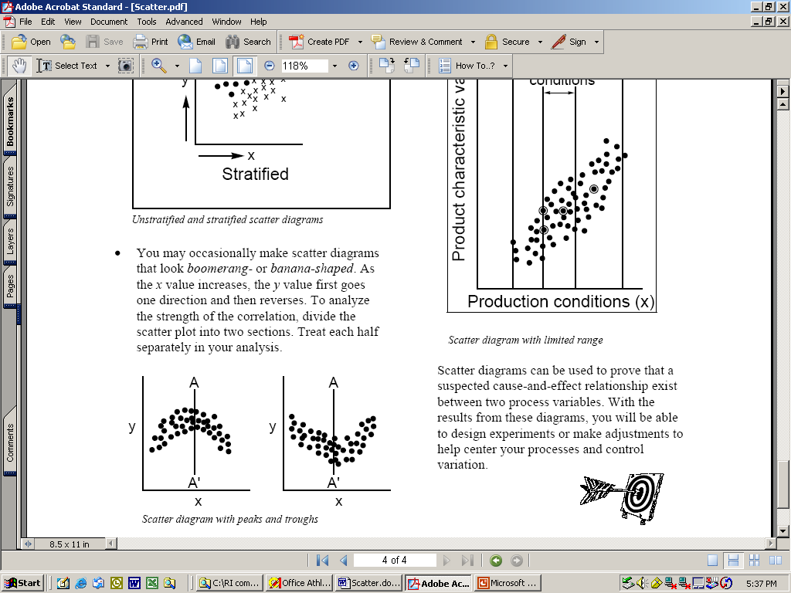
Scatter Diagrams
You may occasionally get scatter diagrams that look boomerang- or banana-shaped.
    To analyze the strength of the correlation, divide the scatter plot into two sections.
    Treat each half separately in your analysis
Benefits:
Helps identify and test probable causes.
By knowing which elements of your process are related and how they are related, you will know what to control or what to vary to affect a quality characteristic.
Notes:
To control variation in any process -it is absolutely essential that you understand which causes are generating which effects.

